Slide 1


Deception Detection using Facial Action Units
Candidato: Orfanelli Emanuele
Relatore: Luigi Cinque
Correlatore: Danilo Avola

Slide 2
Outline
Aim of the thesis
Use cases
System Architecture
Experiments and Results
Future work
Notes:
Durante questa presentazione vi parlero’ dell’obiettivo
Inizialmente vi esporro’..

Slide 3

Aim of the thesis
Goal: understand if it’s possible correctly to classify videos containing truthful or deceptive statements.
In particular by performing the analysis of facial muscle movements during the video.
Notes:
L’obiettivo di questa tesi e’ capire se e’ possibile classificare correttamente video in cui appaiono soggetti che dicono bugie o verita’, in particolare analizzandone i movimenti dei muscoli facciali durante il video.

Slide 4
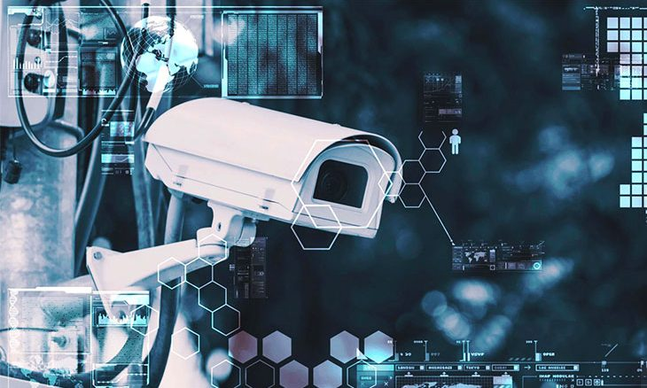
Use cases
Security checks (airport, train stations…);
Interviews;
Police interrogation;
Speech analysis (political).
Notes:
Security checks = controlli di sicurezza
Usato dalla polizia come aiuto per gli interrogatori a criminali o sospettati
Analisi dei discorsi di candidati a ruoli politici

Slide 5
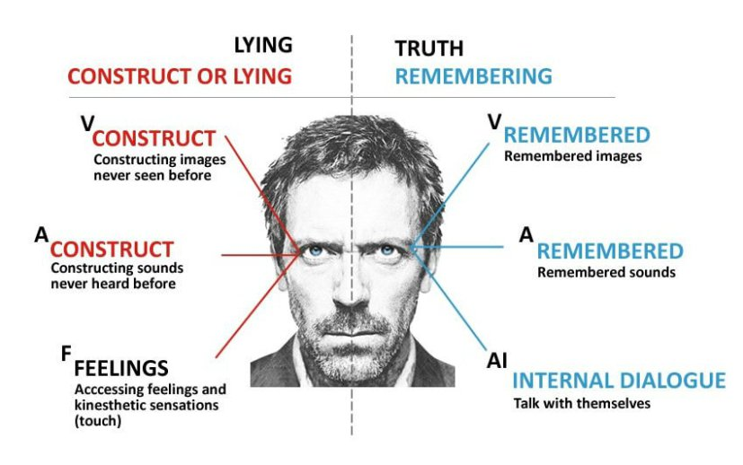
Different ways to detect lies
Psychological
Body language, micro-expressions, eye position;
Speech analysis
Speed, patterns, choice of words;
Neuroscience
EEG, fMRI;
Polygraph
Notes:
- Talk about contact and non contact, invasiveness.
La letteratura fornisce diversi metodi per capire se un soggetto mente o dice la verita’:
Psicologici:
Analisi del discorso
Neuroscientifici
Immagini termiche

Slide 6
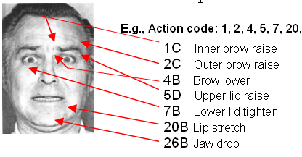
Action Units
Action Units (AU) are a contraction or relaxation of one or more muscles.
AUs can be used to codify emotions and expressions through the muscles involved and the intensity of the movements.
Notes:
Can we identify a pattern for truth and lies by decomposing them into their fundamental muscle movements?
Le AU possono essere utilizzate per codificare le emozioni attraverso lo studio dei movimenti muscolari dei soggetti e delle loro intensita’.
Breve accenno a FACS

Slide 7
Idea
Decompose truthful and deceptive statements into Action Units.
Truthful and deceptive statements should present different Action Units combinations and frequency.
Notes:
Decomporre menzogne e verita’ che troviamo nei video nelle Action Units utilizzate dai soggetti mentre le dicono.

Slide 8
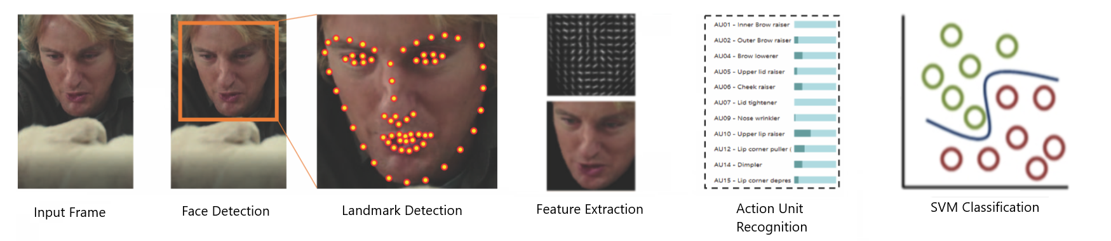
Architecture
Input Video;
Face Detection;
Landmark Detection;
Feature Extraction;
AU Recognition;
SVM Classification;
Notes:
Ad alto livello il nostro Sistema funziona nel seguente modo:

Slide 9
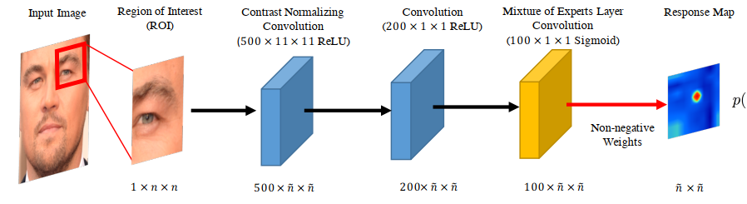
Facial Landmark Detection
Model based approach models both appearance and shape of facial landmarks explicitly with the latter constraining the search space and providing a form of regularization
Two Phases:
Response map computation using Convolutional Experts Network
Shape parameter update
Notes:
Is this too much? Should I skip it since I don’t know too much about this? Should I say I use OF for this? “we use a library…”
https://ibug.doc.ic.ac.uk/media/uploads/documents/tpami_alignment.pdf – spiega un po’ resp map
Riorganizzare slides per spiegare CE CLM cos’e’ un minimo?

Slide 10
Facial Landmark Detection
Convolutional Experts Constrained Local Model (CE-CLM)
Convolutional Experts Network as local detector
Computes a response map to accurately localize individual landmarks by evaluating the landmark alignment probability at individual pixel locations.
Individual landmark alignment is estimated independently of the position of other landmarks.
Notes:
NEW SLIDE MAYBE LIKE THIS

Slide 11
Facial Landmark Detection
Convolutional Experts Constrained Local Model (CE-CLM)
Convolutional Experts Network as local detector
Computes a response map to accurately localize individual landmarks by evaluating the landmark alignment probability at individual pixel locations.
Individual landmark alignment is estimated independently of the position of other landmarks.
Constrained Local Model for shape parameter update
During the parameter update, the positions of all landmarks are updated jointly and penalized for misaligned landmarks and irregular shapes using a point distribution model
Control the landmark locations and to regularize the shape
Notes:
Is this too much? Should I skip it since I don’t know too much about this? Maybe just reduce it.

Slide 12
Feature Extraction
Alignment and Masking
Need for a mapping to a common reference frame to analyze the image.
﻿Similarity transform from the currently detected landmarks to a representation of frontal landmarks from a neutral expression (a projection of mean shape from a 3D PDM)
Procrustes superimposition that minimized the mean square error between aligned pixels
﻿Masking is performed using a convex hull surrounding the feature points
Results in a 112x112 pixel image of the face
Notes:
Una volta estratti I landmark…
REVIEW THIS SLIDE

Slide 13
Feature Extraction
Appearance Features:
12x12 block of 31 dimensional Histogram of Oriented Gradients are extracted.
4464 dimensional vector for the face.
PCA to get a vector of 1379 features.
Geometry Features:
Vector of dimension 227 from landmark locations and shape parameters
Total of ﻿1606 features that define the face.
Notes:
There are two kind of features: appearance and geometry….

Slide 14
Action Unit Detection
Action Unit Classification and Regression.
For AU occurrence detection Support Vector Machines.
For AU intensity estimation Support Vector Regression.
Linear Kernel in both cases.

Slide 15
Action Unit Detection
Trained on three dataset: ﻿DISFA, BP4D-Spontaneous and SEMAINE.
Datasets consist of videos of people subject to emotion inducing tasks, with AUs annotated.
﻿BP4D, SEMAINE and DISFA have three AUs in common: 2, 12, and 17.
SEMAINE and DISFA share AUs 2, 12, 17, 25.
BP4D and DISFA share AUs 1, 2, 4, 6, 12, 15, 17.
Notes:
What are those dataset? Use full names:
-
-
-
Probably too detailed with the Aus in common?

Slide 16
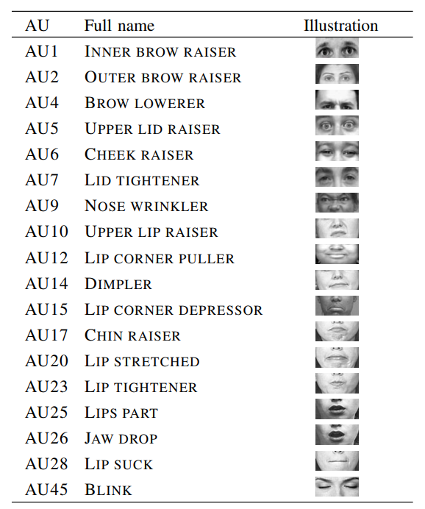
Action Unit Detection
Can recognize the following AUs:

Slide 17
Video Dataset
Real life trial videos. High stakes.
121 videos.
61 deceptive, 60 truthful.
Defendant or witness can be clearly identified.
Three outcomes to label the videos as deceptive or truthful.
Guilty, Non-guilty, Exonerated (reversal of the sentence).
Testimony were verified by police officers.
Work on cutting and removing videos.
Notes:
“Work on cutting…” keep it? Say it better? How much to talk about it?

Slide 18
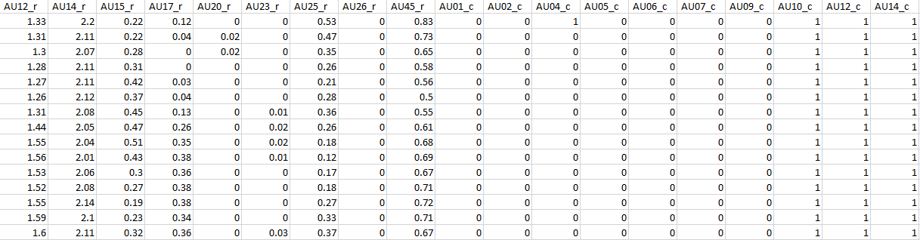
Deception Detection
Pre-processing of data:
Removal of all 0s rows
Presence Boolean 0 or 1
Intensity from 0 to 5
Three sets of data for analysis
Only presence
Only intensity
Presence & Intensity

Slide 19
Deception Detection
Data stats:
~86.000 total frames
~72.000 frames for train set
~14.000 frame test set
Person specific division due to overfitting
Notes:
Dico che abbiamo visto che la divisione in test e train normale overfittava?

Slide 20
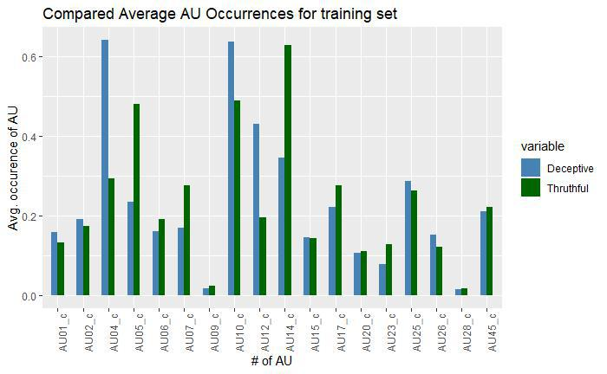
Deception Detection
Frequency analysis of AU occurrences in the train set.
Significant differences for truthful and deceptive in:
AU04
AU05
AU07
AU12
AU14

Slide 21
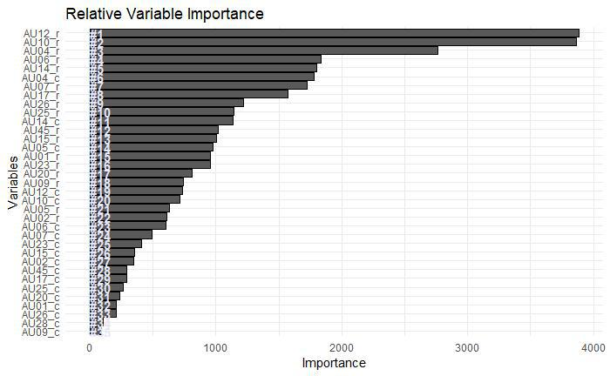
Deception Detection
Variable Importance using Random Forests
Notes:
Don’t have much to say about this

Slide 22
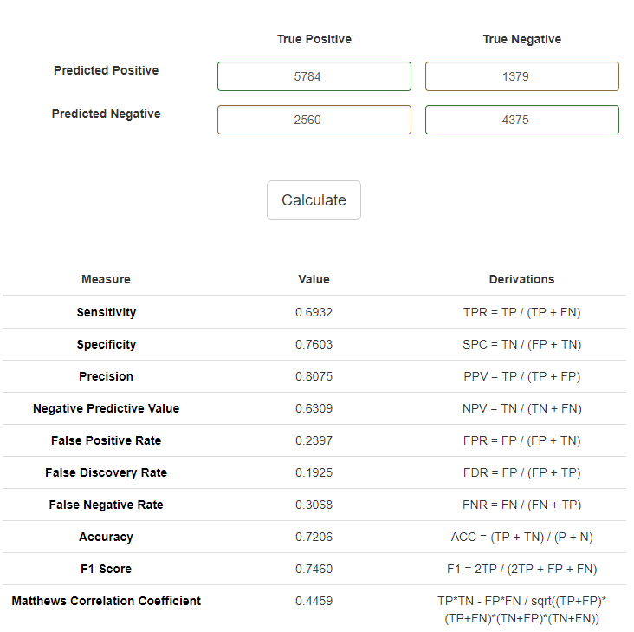
Deception Detection Results
Classification with Radial Basis SVM
72% accuracy on the test set
Notes:
Add confusion matrix?

Slide 23
Future Work
Bigger dataset containing videos of better quality;
Temporal information for Action Units using LSTM;
Extend extraction to more than one person;
Analyze interactions;
Multimodal approach (thermal, body, words).

Slide 24
Thank you

Slide 25

Questions?

